Slide 1


Slide 2

The cryptography systems we have studied so far provide secrecy, or confidentiality, but not integrity.
Message integrity
There are occasions on which we may not even need secrecy, but instead
must have integrity(ie. message should not be modified)
Eg : Mr A has written a will to distribute his property upon his death.
The will need not be encrypted. Anyone can examine his will after his death. But the integiry of the will needs to be preserved. The contents should not be changed.
How to preserve integrity?
Use fingerprint/signature at the bottom of the document.
To ensure integrity, the fingerprint on the document has to match the
fingerprint stored in a file. If they are not the same , then the document is not from A.

Slide 3

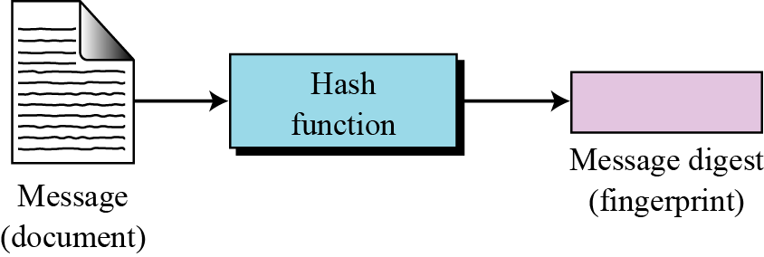
The electronic equivalent of the document and fingerprint pair is the message and message digest pair.
To preserve the integrity of a message, the message is passed through an algorithm called a cryptographic hash function.
The function creates a compressed image of the message that can be used like a fingerprint.

Slide 4
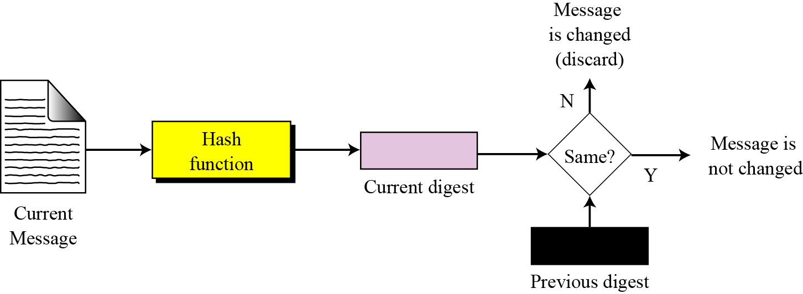
To check the integrity of a message or document, we run the cryptographic hash function again and compare the new message digest with the previous one. If both are the same, we are sure that the original message has not been changed. Figure shows the idea.
Difference between document/fingerprint and message/messagedigest
Document/fingerprint are physically linked together. Message and message digest pair can be sent seperately.

Slide 5
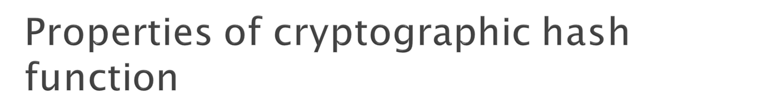
Preimage resistance Second preimage Collision resistance
resistance
Preimage resistance :
For a given value y=h(x), it is computationally infeasible to find
x’ such that h(x’)= y
i.e It is difficult for an attacker to compute the preimage of the hashed value.

Slide 6
2. Second pre-image resistance.
The attacker, if given value of x, it is computationally infeasble to find y, y ≠x such that H(y) = H(x).
Also called weak collision resistance.
It means that an alternate message hashing to the same value
cannot be found.
3. Collision resistance.
It is computationally infeasible to find any pair ( x,y) such that
H(x) = H(y).
Also referred to a strong collision.

Slide 7

Preimage resistant: given h, hard to find m such that h = hash(m)
Second preimage resistant: given m1, hard to find m2 (≠ m1) such that hash(m1) = hash(m2)
Collision-resistant: hard to find m1 and m2, m2 ≠ m1, such that hash(m1) = hash(m2)

Slide 8

Developed by Ron Rivest of MIT.
Was the mostly used secure hash algorithm till it was cracked.
Takes an input msg of arbitrary length and produsec as output a 128-bit message digest.
The input is processed in 512-bit block.

Slide 9
H_{MD5} = 4-round compression function
message
Length 64 bits
Padding bits
Message
100…0
L X 512 bits
512 bits
...
...
Block₀
Block₁
Block_{n}
Block_{L-1}
512
128
MD
Buffer₀
_{IV}
H_{MD5}
H_{MD5}
H_{MD5}
H_{MD5}
MD
buffer_{L-1}
MD
buffer₁
MD
buffer_{n}
128-bit
digest

Slide 10
Steps
Step 1 : Append padding bits.
The message is padded so that it’s length is 64 bits than an
integer multiple of 512 bits.
Padding bits are always added even if the message is already of the desired length.
Padding consists of single 1 bit followed by the necessary no. of zeroes.
No. of padding bits is in the range 1-512 bits.
Step1 2 : Append length
A 64-bit representation of the length in bits of original message before padding is appended to the result of step1.

Slide 11
Example of steps 1 and 2
Assume message length = 1000 bits
No. of padding bits =(512 x 3) -1000 -64=472
i.e 1 followed by 471 0’s
Message length = 0…..011111011000 [binary equivalent of 1000]
512
512
512
512
512
488
P
P
Blk 1
Blk 2
Blk 3
64 bits

Slide 12
Let message length=448 bits
No. of padding bits = 512 bits
Let message length be 112 bits
No. o f padding bits =512-112-64=336
512
512
448
P
P
Blk 1
Blk 2
64 bits
512
112
336
64
10…..0

Slide 13
Note : Results of steps 1 and 2 is an expanded message i.e an
integer multiple of 512 and is represented as a sequence of
512-bit blocks Y0,Y1…YL-1
Step 3 : A 128 bit buffer is used to hold intermediate and final results of the hash function.
The buffer is represented as 4 32 bit registers ( A,B,C,D)
These registers are initialized to the following 32 bit hex values
word A: 01 23 45 67
word B: 89 AB CD EF
word C: FE DC BA 98
word D: 76 54 32 10

Slide 14
Step 4 : Process message in 512 bit blocks
The heart of MD5 is a compression function (HMD5) which consists of 4 round of processing.
Each round consists of 16 identical steps.
The four rounds have similar structure but each uses a different primitive logical function, referred to as (F,G,H,I)

Slide 15
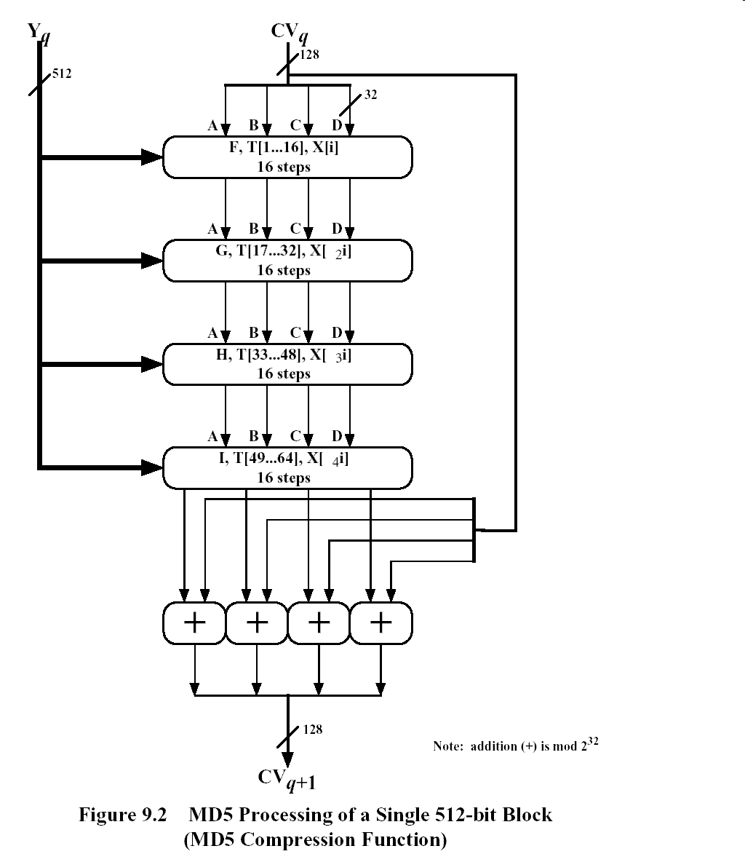

Slide 16
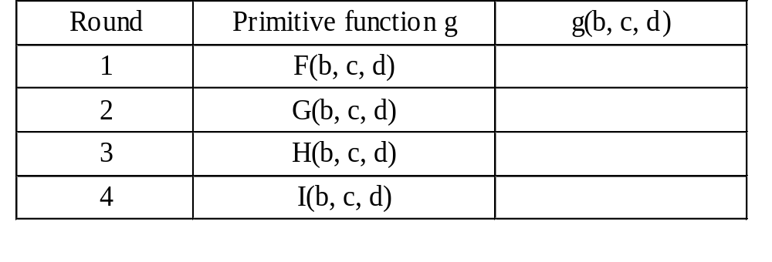
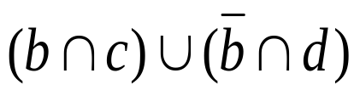
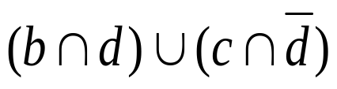

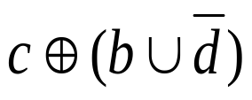
Pimitive functions
OR
AND
⊕ OR

Slide 17
Each round takes as input the current 512-bit block being processed(Yq) and the 128 –bit buffer value ABCD and updates the contents of the buffer.
Each round also makes use of ¼ of a 64-element table T[1..64]constructed from the sine function.
The ith element of T, T[i] has the value eual to the integer part of 2³² x abs(sin(i)) i is in radians
The o/p of the 4th round is added to the first round CVq to produce CVq+1
Step 5 : After all L 512 bit blocks have been processed , the o/p from the Lth stage is the 128 bit message digest

Slide 18
Table T, constructed from the sine function
───────────────────────────────────
T[1] = D76AA478 T[17] = F61E2562 T[33] = FFFA3942 T[49] = F4292244
T[2] = E8C7B756 T[18] = C040B340 T[34] = 8771F681 T[50] = 432AFF97
T[3] = 242070DB T[19] = 265E5A51 T[35] = 699D6122 T[51] = AB9423A7
T[4] = C1BDCEEE T[20] = E9B6C7AA T[36] = FDE5380C T[52] = FC93A039
T[5] = F57C0FAF T[21] = D62F105D T[37] = A4BEEA44 T[53] = 655B59C3
T[6] = 4787C62A T[22] = 02441453 T[38] = 4BDECFA9 T[54] = 8F0CCC92
T[7] = A8304613 T[23] = D8A1E681 T[39] = F6BB4B60 T[55] = FFEFF47D
T[8] = FD469501 T[24] = E7D3FBC8 T[40] = BEBFBC70 T[56] = 85845DD1
T[9] = 698098D8 T[25] = 21E1CDE6 T[41] = 289B7EC6 T[57] = 6FA87E4F
T[10] = 8B44F7AF T[26] = C33707D6 T[42] = EAA127FA T[58] = FE2CE6E0
T[11] = FFFF5BB1 T[27] = F4D50D87 T[43] = D4EF3085 T[59] = A3014314
T[12] = 895CD7BE T[28] = 455A14ED T[44] = 04881D05 T[60] = 4E0811A1
T[13] = 6B901122 T[29] = A9E3E905 T[45] = D9D4D039 T[61] = F7537E82
T[14] = FD987193 T[30] = FCEFA3F8 T[46] = E6DB99E5 T[62] = BD3AF235
T[15] = A679438E T[31] = 676F02D9 T[47] = 1FA27CF8 T[63] = 2AD7D2BB
T[16] = 49B40821 T[32] = 8D2A4C8A T[48] = C4AC5665 T[64] = EB86D391
───────────────────────────────────

Slide 19
- Each round is 16 steps, this is an ex.of a single step
- The order in which a,b,c,d is used produces a circular right
shift of one word for each step
A
B
C
D
+
g
X[k]
+
T[i]
+
CLS_{s}
g = primitive function
X[k] = kth 32-bit word in one of the 512 bit blocks
T[i] = 2³² x abs(sin(i))
i -is in radians
i varies from 1-64
CLSs- circular left shift of
32-bits by s bits
+
A
B
C
D

